Slide 1
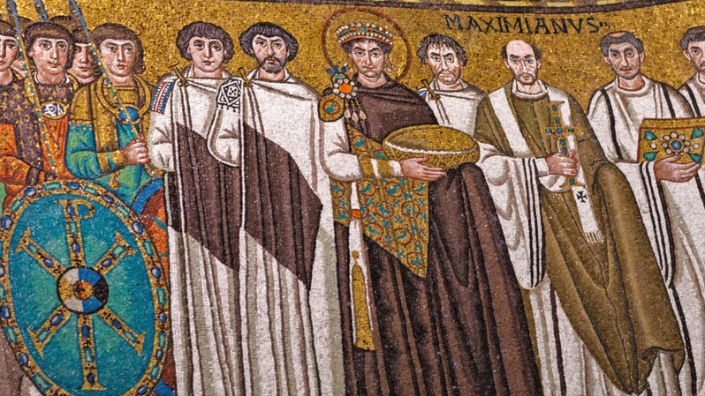
The Early Church and the Eucharist
St. Stephen’s Mystagogy
Barbara Harrington, Phd

Slide 2
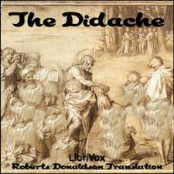
The Didache (125): Eucharist Is For Unity Among Believers
“On the Lord’s day, when you have been gathered together, break bread and celebrate the Eucharist.
But first confess your sins so that your offering may be pure. If anyone has a quarrel with his neighbor, that person should not join you until he has been reconciled.
Your sacrifice must not be defiled. In this regard, the Lord has said: In every place and time offer me a pure sacrifice. ”
Notes:
The Didache is an anonymous Greek work from AD 125 in Alexandria Egypt. However, the Didache is composed of two earlier documents that could date back to the time of the apostles themselves.

Slide 3
“Christ became what we are, so He could make us what He is.” St. Athanasius

Slide 4
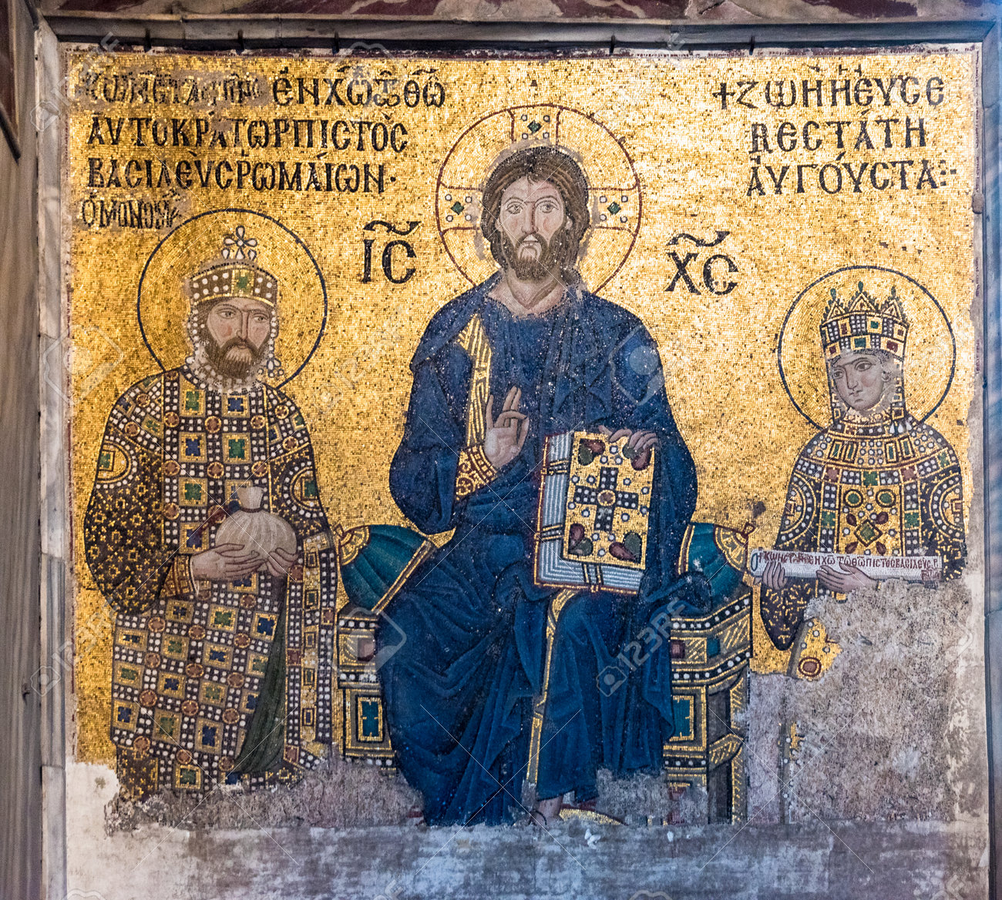
Council of Nicea – “Fully Man and fully God”
313AD – Church moves from private homes to ‘basilicas.’
Gradually Christ’s Divinity becomes more associated with the earthly power of kings and emperors and thus separated from the average person.
Notes:
Byzantine mosaic of Jesus Christ is sitting on throne with Empress Zoe and Emperor Constantine IX Monomachus in Hagia Sophia,Greek Orthodox Christian church.Istanbul, Turkey

Slide 5
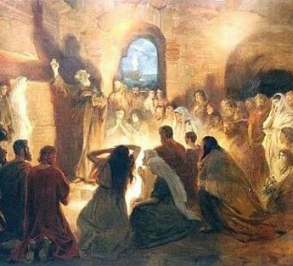
Ranks of the Neophytes ”Sancta, sanctis, foris canes.”
The Catechumens (no real affiliation; couldn’t attend any sacraments)
The Seekers (Presented to the bishop)
The Faithful or Illuminati (admitted to baptism and eventually Eucharist)

Slide 6
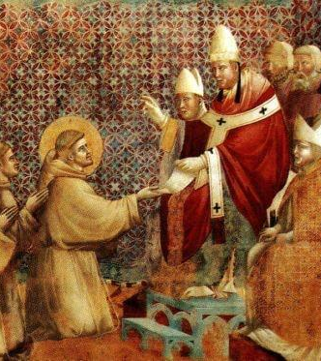
Reception of Communion – Warding off Scruples
St. Paul – “First day of the week”
Tertullian (200AD) – any time
Sts. Cyprian/Ambrose/Jerome (3^{rd/}4th cent) – daily
St. John Chrysostom – Whenever you are at Mass!
St. Bede – (800) – Bemoans that the people aren’t receiving enough
Fourth Lateran Council / Pope Innocent III (1215) – Under pain of excommunication – must receive once a year

Slide 7
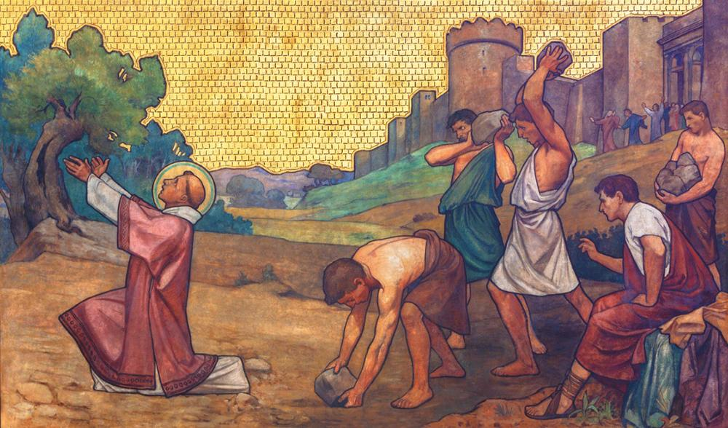
Oikonomia and “The Discipline of the Secret”
“Do not give to dogs what is holy. Neither cast your perarls before swine.” Matt 7:6
-
“We don’t talk about _________.”
Notes:
Literally means “good and prudent handling”… Disciplia Arcana
Grew out of the caution of the persecuted Church.
- Christianity was growing among the slaves and poor sometimes because of “all things in common.” After 313, people were converting for all the wrong reasons.
- Heresy was rampant (largely uneducated people teaching from word of mouth).

Slide 8
The Commingling
“…in the water is understood the people, but in the wine is showed the blood of Christ. But when the water is mingled in the cup with wine…that mixture cannot any more be separated. So, nothing can separate the Church from Christ… “
Cyprian,To Caeilius,Epistle 62(63):13(A.D. 253)Caeilius,Epistle 62(63):13(A.D. 253).

Slide 9
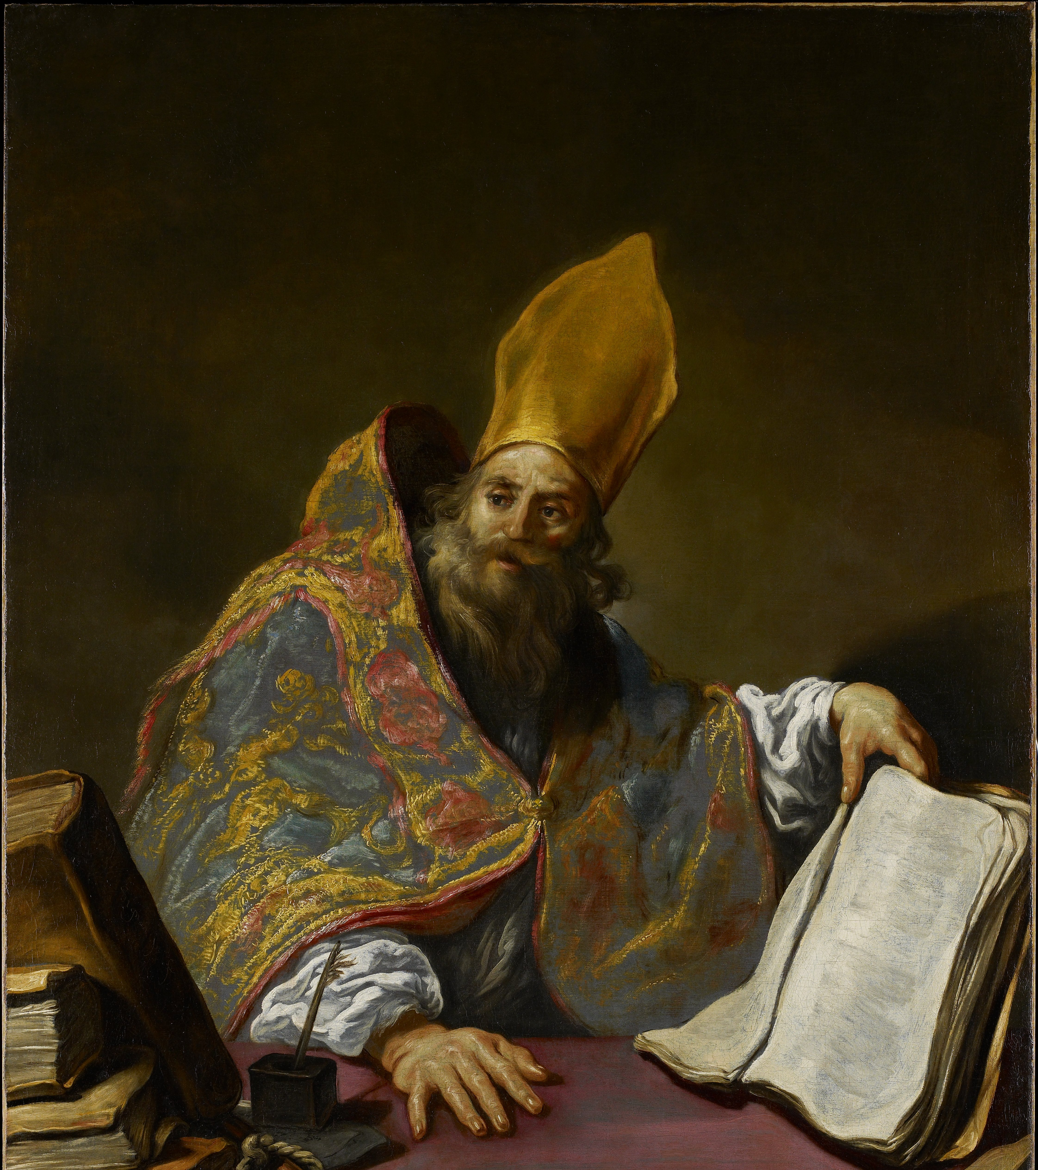
Take Christ at His Word: “It is the consecration!” St. Ambrose of Milan, 333-397
“Let us prove that this is not what nature has shaped it to be, but what the blessing has consecrated;
for the power of the blessing is greater than that of nature,
because by the blessing even nature itself is changed.” (The Mysteries)

Slide 10
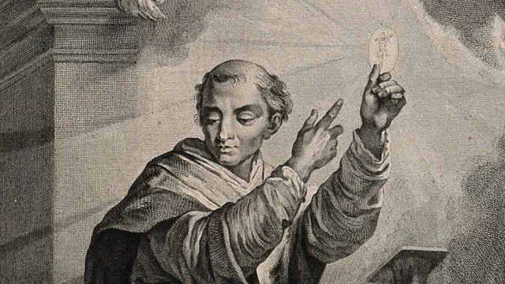
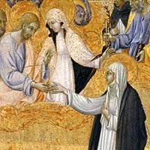
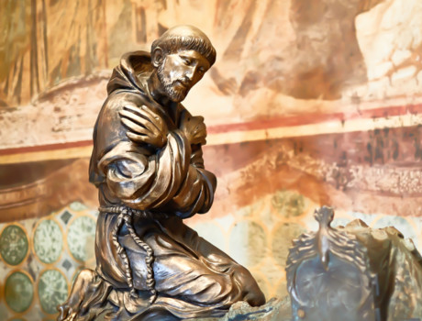
All the Greatest Theologians Encouraged Frequent Communion
Notes:
St. Francis. ““Above everything else, I want this most Holy Sacrament to be honored and venerated and reserved in places which are richly ornamented.”
St Gregory prayed an the Eucharist became flesh in front of a woman who was laughing at it.

Slide 16
The “Commingling”
"For the blood of the grape--that is, the Word--desired to be mixed with water, as His blood is mingled with salvation. And the blood of the Lord is twofold. For there is the blood of His flesh, by which we are redeemed from corruption; and the spiritual, that by which we are anointed. And to drink the blood of Jesus, is to become partaker of the Lord's immortality; the Spirit being the energetic principle of the Word, as blood is of flesh. Accordingly, as wine is blended with water, so is the Spirit with man. And the one, the mixture of wine and water, nourishes to faith; while the other, the Spirit, conducts to immortality. And the mixture of both--of the water and of the Word--is called Eucharist, renowned and glorious grace; and they who by faith partake of it are sanctified both in body and soul."
Clement of Alexandria,The Instructor,2(ante A.D. 202),in ANF,II:242

Slide 17
““Recognize in the bread what hung on the cross, and in the cup what flowed from his side.”
(St. Augustine, Ltr to Neophytes)

Slide 18
The Effect of the Eucharist is Binding the Church Together in Charity.

Slide 21
Catholic Oath of 1079
Against Eucharistic Heresies
I believe in my heart and openly profess that the bread and wine placed upon the altar are, by the mystery of the sacred prayer and the words of the Redeemer, substantially changed into the true and life-giving flesh and blood of Jesus Christ our Lord, and that after the consecration, there is present the true Body and Blood of Christ which was born of the Virgin and, offered up for the salvation of the world, hung on the cross and now sits at the right hand of the Father, and that there is present the true Blood of Christ which flowed from His side. They are present not only by means of a sign and of the efficacy of the sacrament, but also in the very reality and truth of their nature and substance.
Notes:
In response to the Imanation heresy of a monk from the French Abbey Ratramnus (d. 868) held that Christ’s Body in the Eucharist was symbolic rather than corporeal.
Within two centuries the issue had reached such a point of gravity that a formal declaration was evoked from the Holy See. In 1079, Archdeacon Berengar of Tours was required by Gregory VII to accept the following declaration of faith in the Eucharistic presence:

