Slide 1
Church Teaching on the Eucharist and
How to Talk About it
Barbara Harrington, PhD
St. Stephen’s Mystagogy

Slide 2
Catechism on the Eucharist – 31 pages

Slide 3
“So, what do you mean by Eucharist?

Slide 4
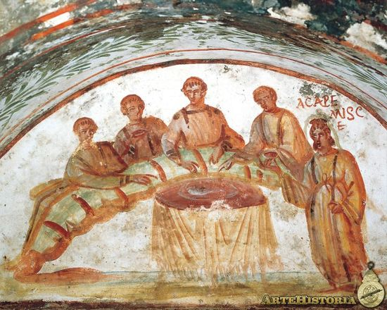
Eucharist
(Greek)
“Well”
+
“Grateful”
(That is, do gratitude as best as you can.)

Slide 5
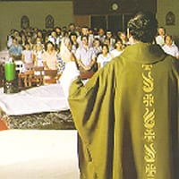
We mean ALL the names we give it.
Communion
(Greek) Com = “With”
Unus = “Oneness”
The Lord’s Supper
Because it reenacts the Last Supper. But also it is the Divine Initiative. He calls, He offers, He serves, He is the food.
The Holy Sacrifice
Holy Mass
“Ite missa est.”

Slide 6
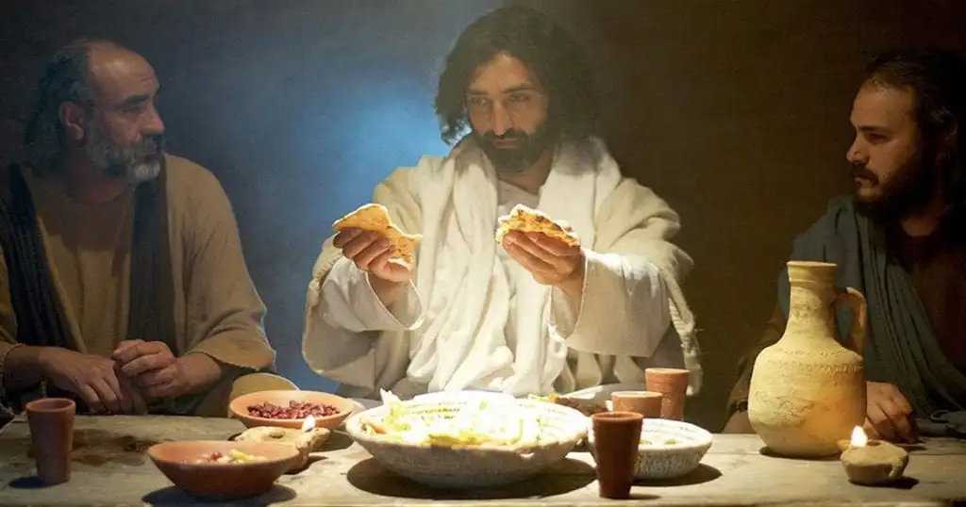
The Breaking of the Bread – indicates we share with each other
Notes:
Most common term used in the early Church

Slide 7
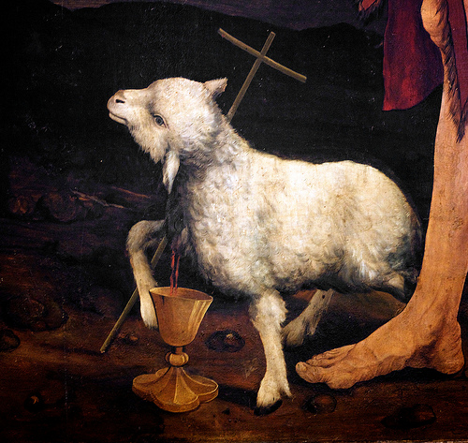
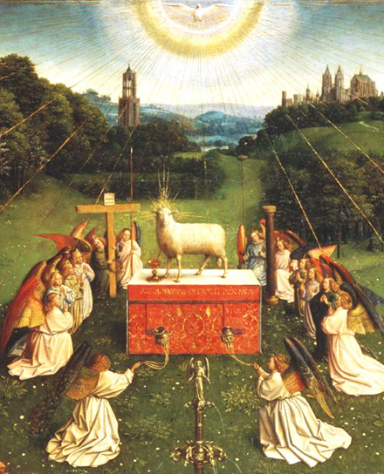
The Paschal Feast “Our BLESSING CUP is a communion with the Blood of Christ.”

Slide 9
“The Bread of Life” Because it contains the stuff of Divinity, Supernatural Grace, the life of God which we lost through Original Wound.

Slide 10
The “Life of God” manifests in us as:

Slide 11
“Okay, but you don’t really mean you’re eating the actual body of Jesus, right?”

Slide 12
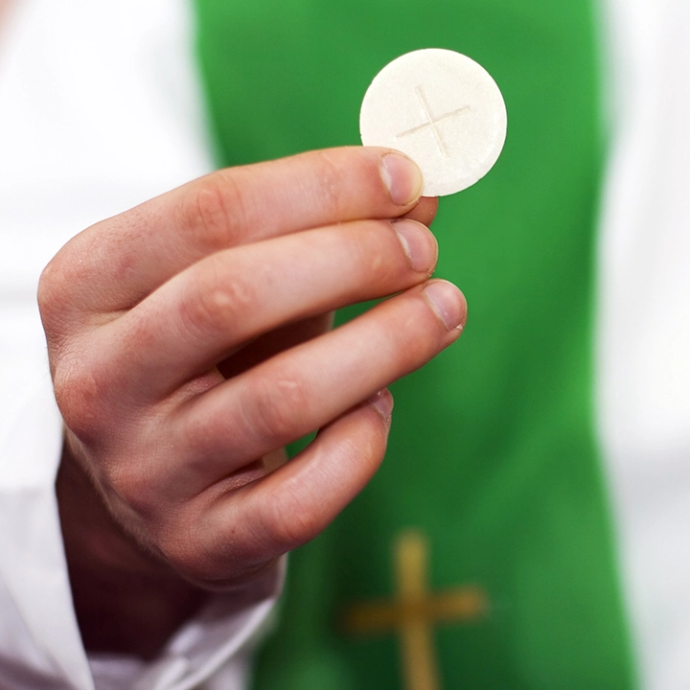
You have to understand Substance vs. Accidents
We believe
that we are eating
the substance
of Jesus’ body.

Slide 14
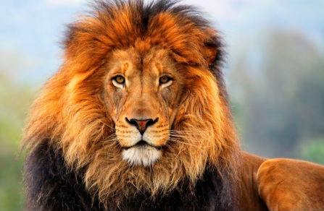
Ousia – “Substance” or “Essence”: “The thing about a thing which makes it that thing and no other thing.”
What is “lion-ness”?
Notes:
The Council of Nicea fathers used the language of Greek philosophy to resolve the debate. Think about that. They didn’t look to the Bible because it was clear that everyone was reading the Bible passages they wanted to to prove their case.
Iin philosophy, essence is the attribute or set of attributes that make an entity or substance what it fundamentally is, and which it has by necessity, and without which it loses its identity. Contrasted with accident.
From Aristotle, “The What it is”

Slide 15
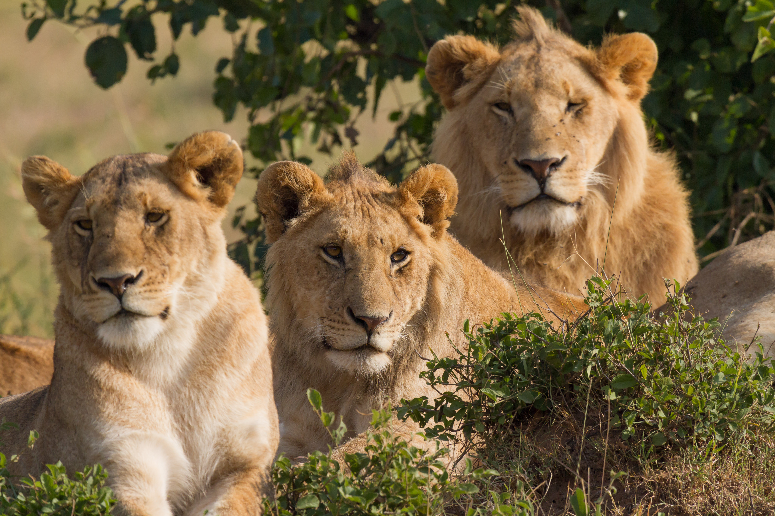
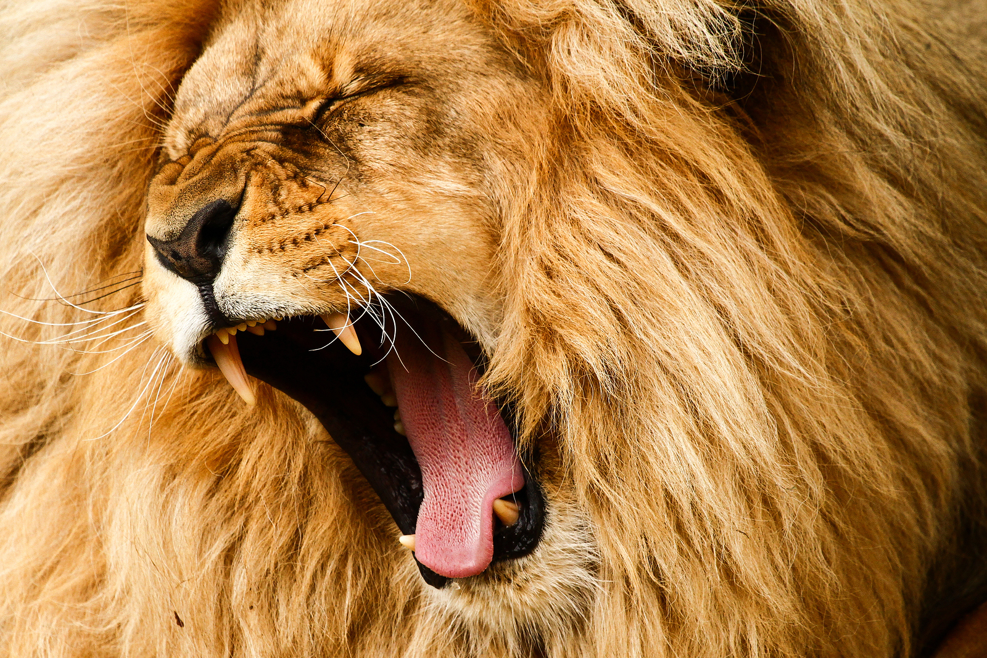
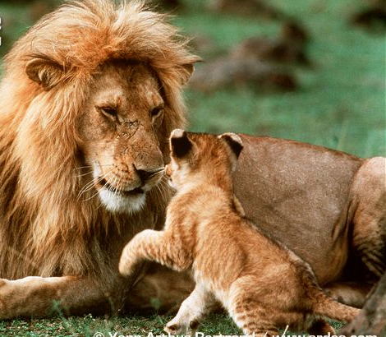
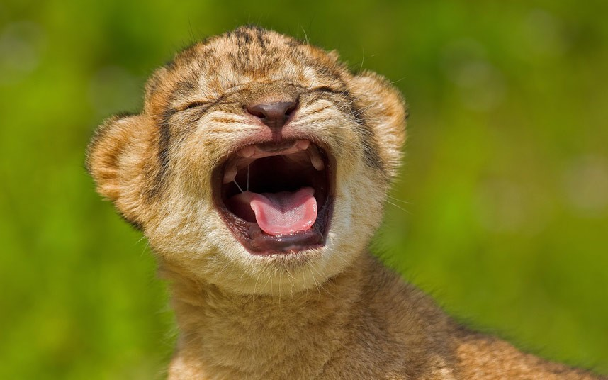
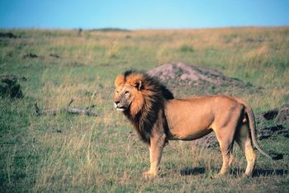
Notes:
A lion is that which comes from Africa, is a big cat, has four legs, a mane and a tale.
A lion sometimes doesn’t have a mane.
A lion is ferocious and has big teeth.
Except when it is not ferocious...
And has no teeth.

Slide 16
Is this a lion?

Slide 17
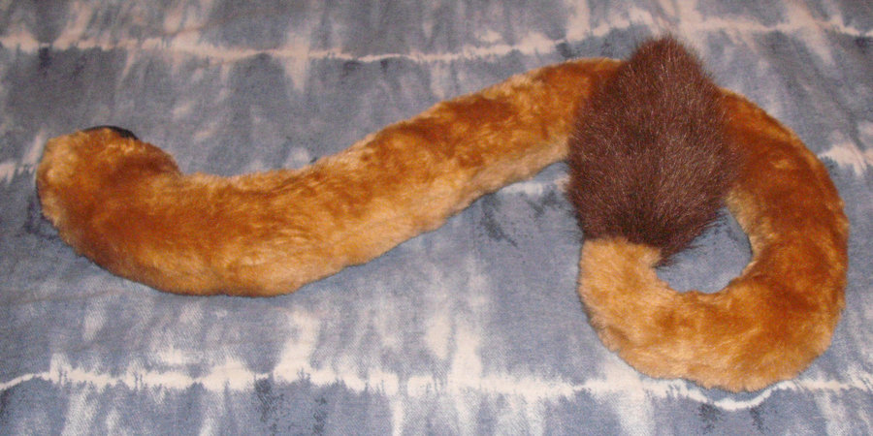
If I cut his tale off is he still a lion?
Is the tail a lion? No, the tail is an ACCIDENT.
Notes:
What about if I cut off his leg and his tale? How about if I cut off all four legs, is it still a lion? Imagine the torso of a lion without a head, legs, or tale. Would you say, “And here, we have a lion?” Where did the lion go?

Slide 19
“So, how exactly does it work?”

Slide 20
We don’t know how it happens.
But we do know WHEN it happens.

Slide 21
Willed agreements between God and man.
Man does this and then God does that.

Slide 22
When God’s people present the matter and form of the Eucharist, the Holy Spirit transforms it into Christ’s Body and Blood.
The FORM of the Eucharist
(An ordained priest saying)
“This is my Body.”
“This is the cup of my blood.”
Notes:
The Preface of the anaphoraThe form of the Eucharist consists in the words of Consecration as set forth in the Roman Sacramentary (i.e. Missal). [Fr. Francis A. Carbine, Archdiocese of Philadelphia, seminary notes on the sacraments, p. 7; cf. CCC, #1412.] All the priest would really have to do to say Mass would be to say the words of Consecration: “This is My Body. This is My Blood,” over the bread and wine

Slide 23
Why Bread and Wine…
“…they continue also to signify the goodness of creation.”
In the Offertory we give thanks to the Creator for bread and wine, fruit of the "work of human hands," but above all as "fruit of the earth" and "of the vine" - gifts of the Creator.”

Slide 24
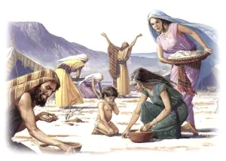
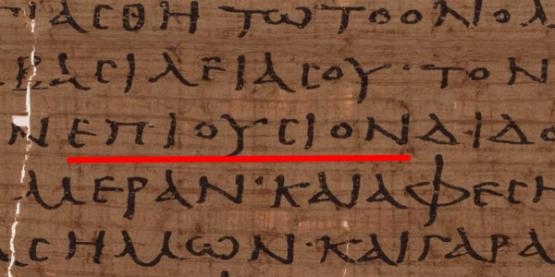
Give us this day our “superessential” Bread…
The original Greek translates to "Give us today our epiousion bread.” Which has no clear definition.
When translating from Koine Greek to Latin in AD 382 St. Jerome used "quotidianum" which is where we get "daily" from in the English.
Current Catholic consensus is that it refers to the Manna of the New Covenant.

Slide 25
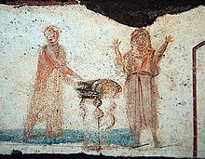
The
“New
Covenant”
“Let us (Eucharist) to the Lord our God.”
“It is right and just.”
Notes:
The preface to the anaphora

Slide 26
“What do you get out of it?

Slide 27
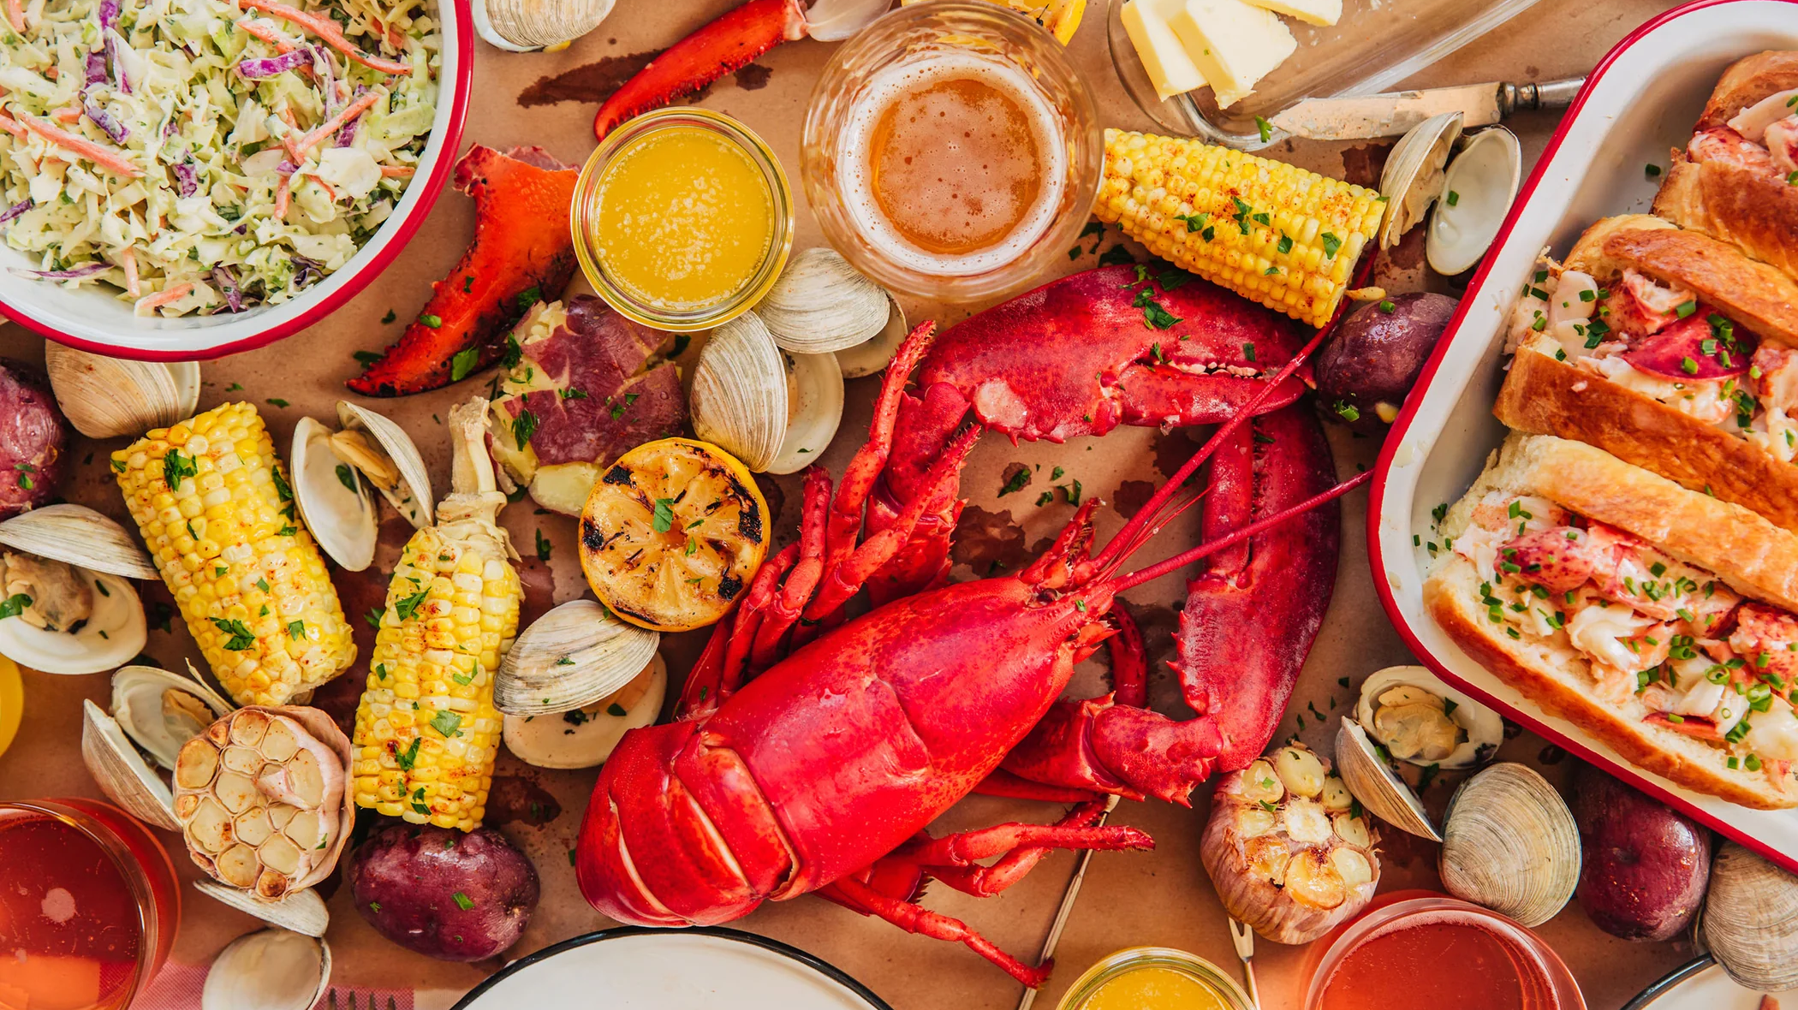
“What material food produces in our bodily life, Holy Communion wonderfully achieves in our spiritual life.” CCC1392

Slide 28
“The Eucharist separates us from sin…. [It]cannot unite us to Christ without at the same time cleansing us from past sins and preserving us from future sins.” CCC1393

Slide 29
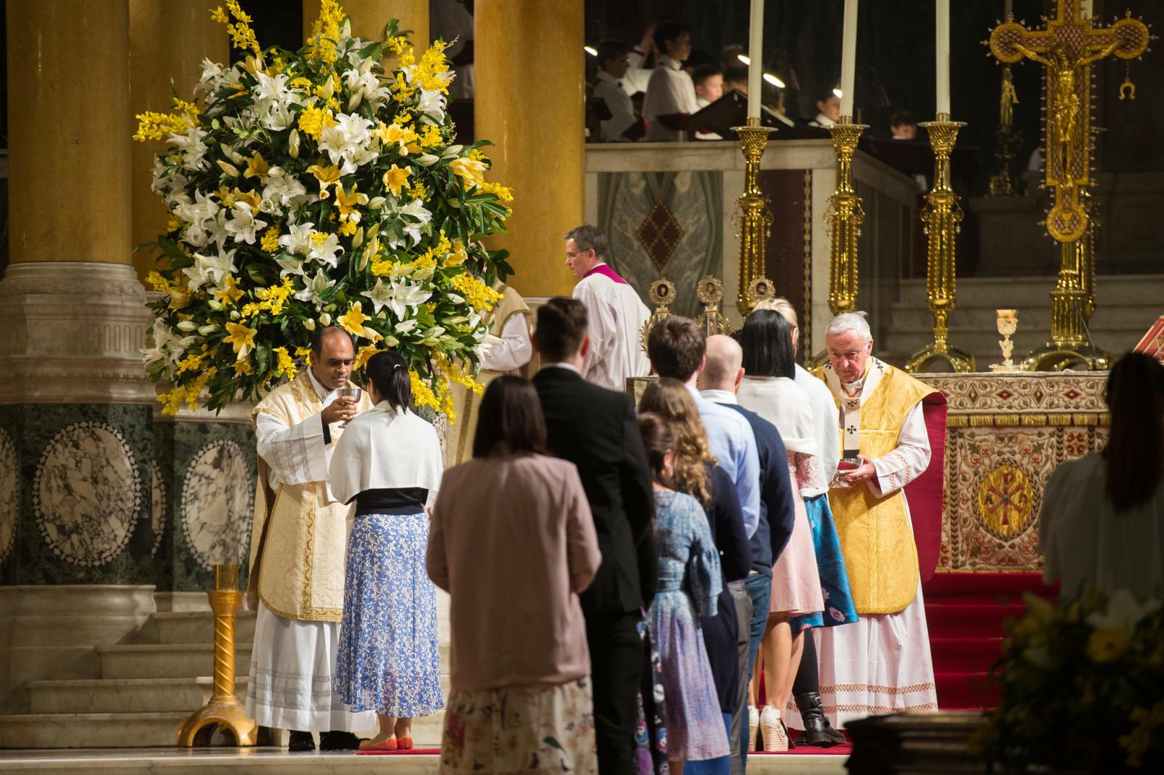
“The Eucharist makes the Church. Through it Christ unites them to all the faithful in one body - the Church.” ccc1396

Slide 30
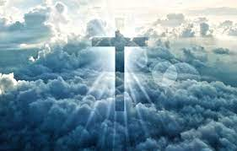
“There is no surer pledge or dearer sign of this great hope in the new heavens and new earth in which righteousness dwells, than the Eucharist.”

Slide 31
“Cool. Can I have some?”

Slide 32
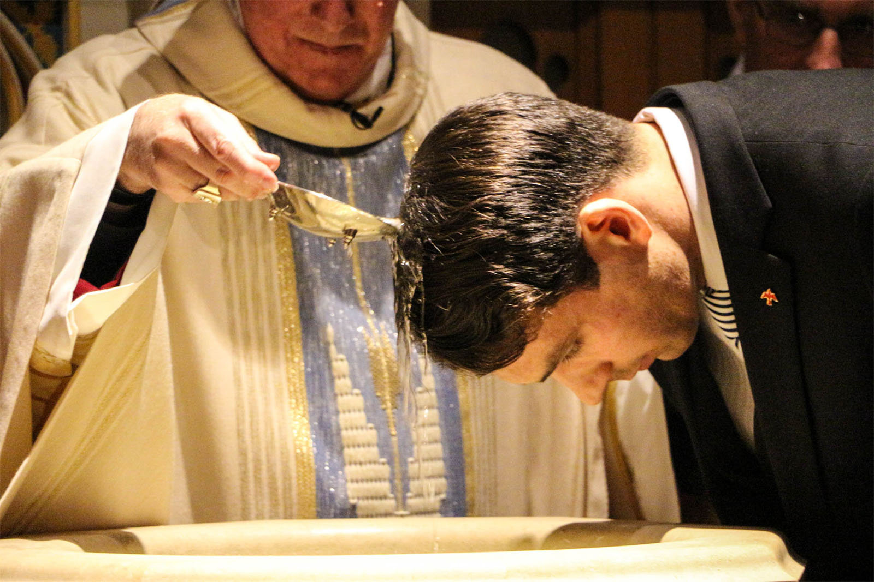
Yes! Just a few administrative details…

Slide 33
“The Holy Eucharist completes Christian initiation.”
It’s Jesus’ gift to His friends.
It’s a public, corporate act of the Church community.
It’s our family meal.

Slide 34
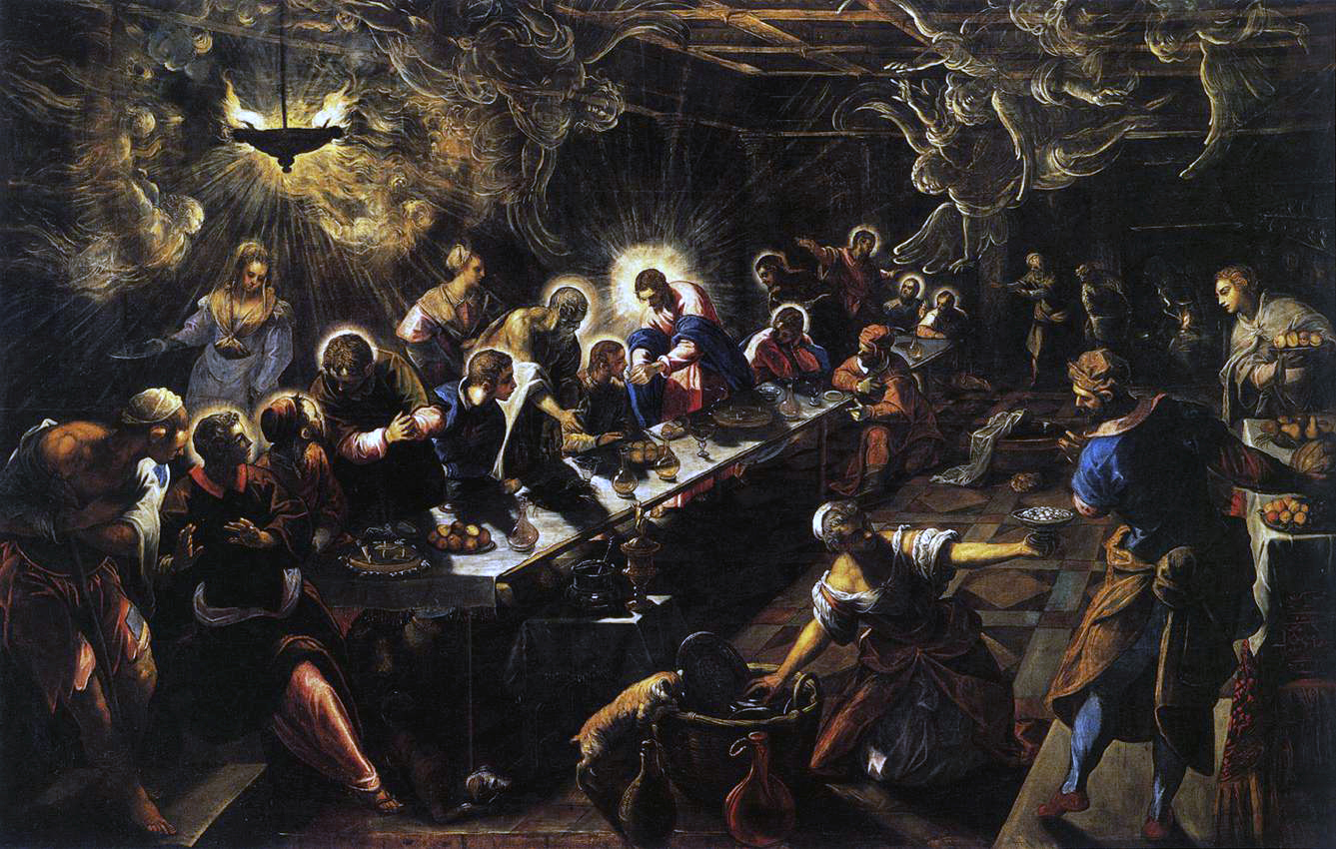
Tinteretto’s Last Supper
Name
Name
Name
Title
Title
Title

Slide 35
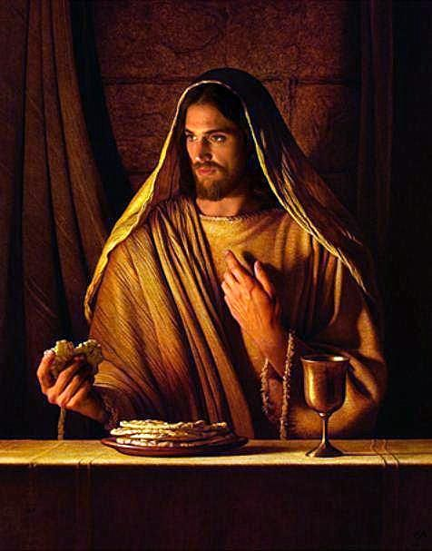
Jesus is the font of all grace.
There is no greater experience in Christian life.

Slide 37
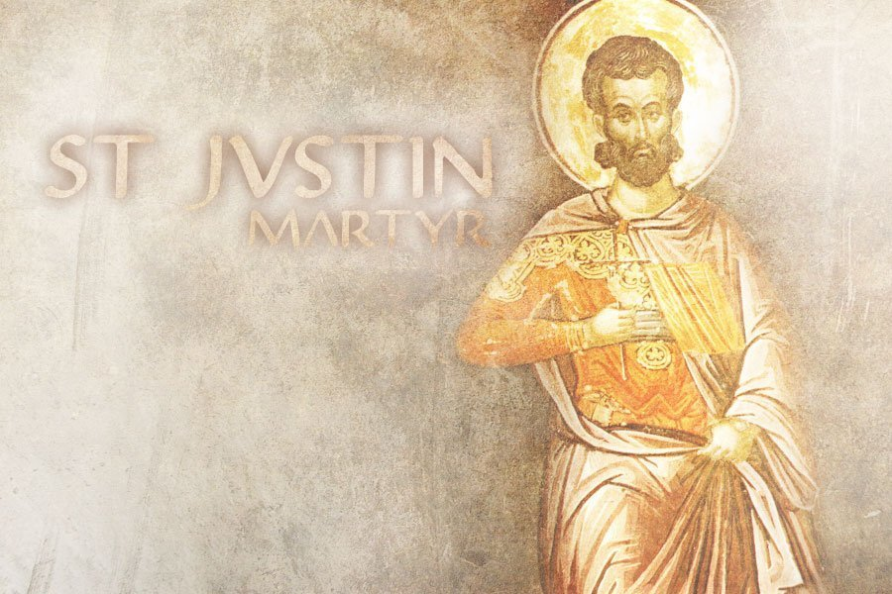
“Because this bread and wine have been eucharisted, no one may take part in it unless he believes that what we teach is true, has received baptism for the forgiveness of sins and new birth, and lives in keeping with what Christ taught."

Slide 38
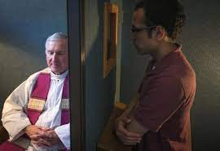
To respond to this invitation we must prepare ourselves for so great and so holy a moment. Anyone conscious of a grave sin must receive the sacrament of Reconciliation before coming to communion.

